Slide 1
STEPHENS CITY LIONS CLUB
NORTHERN VIRGINIA LION’S YOUTH CAMP
MARCH 24, 2026
PRESENTER
LION PHIL SCHRACK, PCC
PAST PRESIDENT OF NVLYC

Slide 2




OFF TO CAMP WE Go!
68
Years of Service

Slide 3



Types of Camping

Slide 4
HISTORY OF NVLYC
Richard Kohlway of the Herndon Lions
Started with a dream
Got support from Chantilly & Oakton Lions Clubs
Search was started in Rappahannock & Clarke Counties
Located a 100 acres farm in Clarke County
Purchase for $10,000
1958-2017 Lion Clubs supported the Camp with fundraising
Build 6 cabins, pavilion & paid off the loan
Bath house and dining hall were built
Dining hall was Completed (2022)
A Well was drilled road repairs were accomplished installed a 5000 Gallon Pressure water tank
Virginia Health Department Approved (Sample Testing every Quarter)
Park West Cabin Remodeled (May 2023)

Slide 5
HISTORY OF NVLYC (con’t)
Warrenton Sunrise (Built February 2013)
Davis Pavilion (Remodeled)
Remodel Fairfax Host (New Baltimore Cabin)
Replaced Bath house (October 2022)
Remodel Woodbridge (Herndon) Cabin
Replaced Roofs on Durant Hall, Park West, Baileys Crossroads, Vienna Host Cabins (April 2023)
Remodeled Caretaker’s Cottage (2024-2025)
Built ARCOLA Learning Center (2024)
Remodeled Clifton, Baileys, Vienna Cabins (2025)

Slide 6
Northern Virginia Lions Youth Camp Officers
Pres: Lion Ken Marr
1st VP: Lion Aron Hinson
2nd VP:PCC Wilma Murphy
Sec: Evelyn Marr
Treas: Lion Mark Armendaris
Scheduler/Advisor: PCC Phil Schrack
District 24-L Cabinet Representatives
Phil Mayo
PCC John Knepper
Director Reg I:
Director Reg II:
Director Reg III: Lion Phil Mayo
Director Reg IV: Lion Bill Poole
Director Reg V:
Director Reg VI: Lion Scott Brown
Director Reg VII:
Director Reg VIII:
IPP/Senior Director: PID JAY Moughon
Senior Director Lion Sharon Schrack

Slide 7
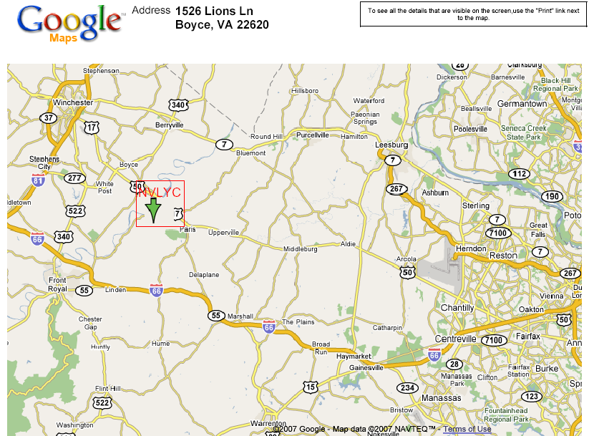
Where is NVLYC?

Slide 8
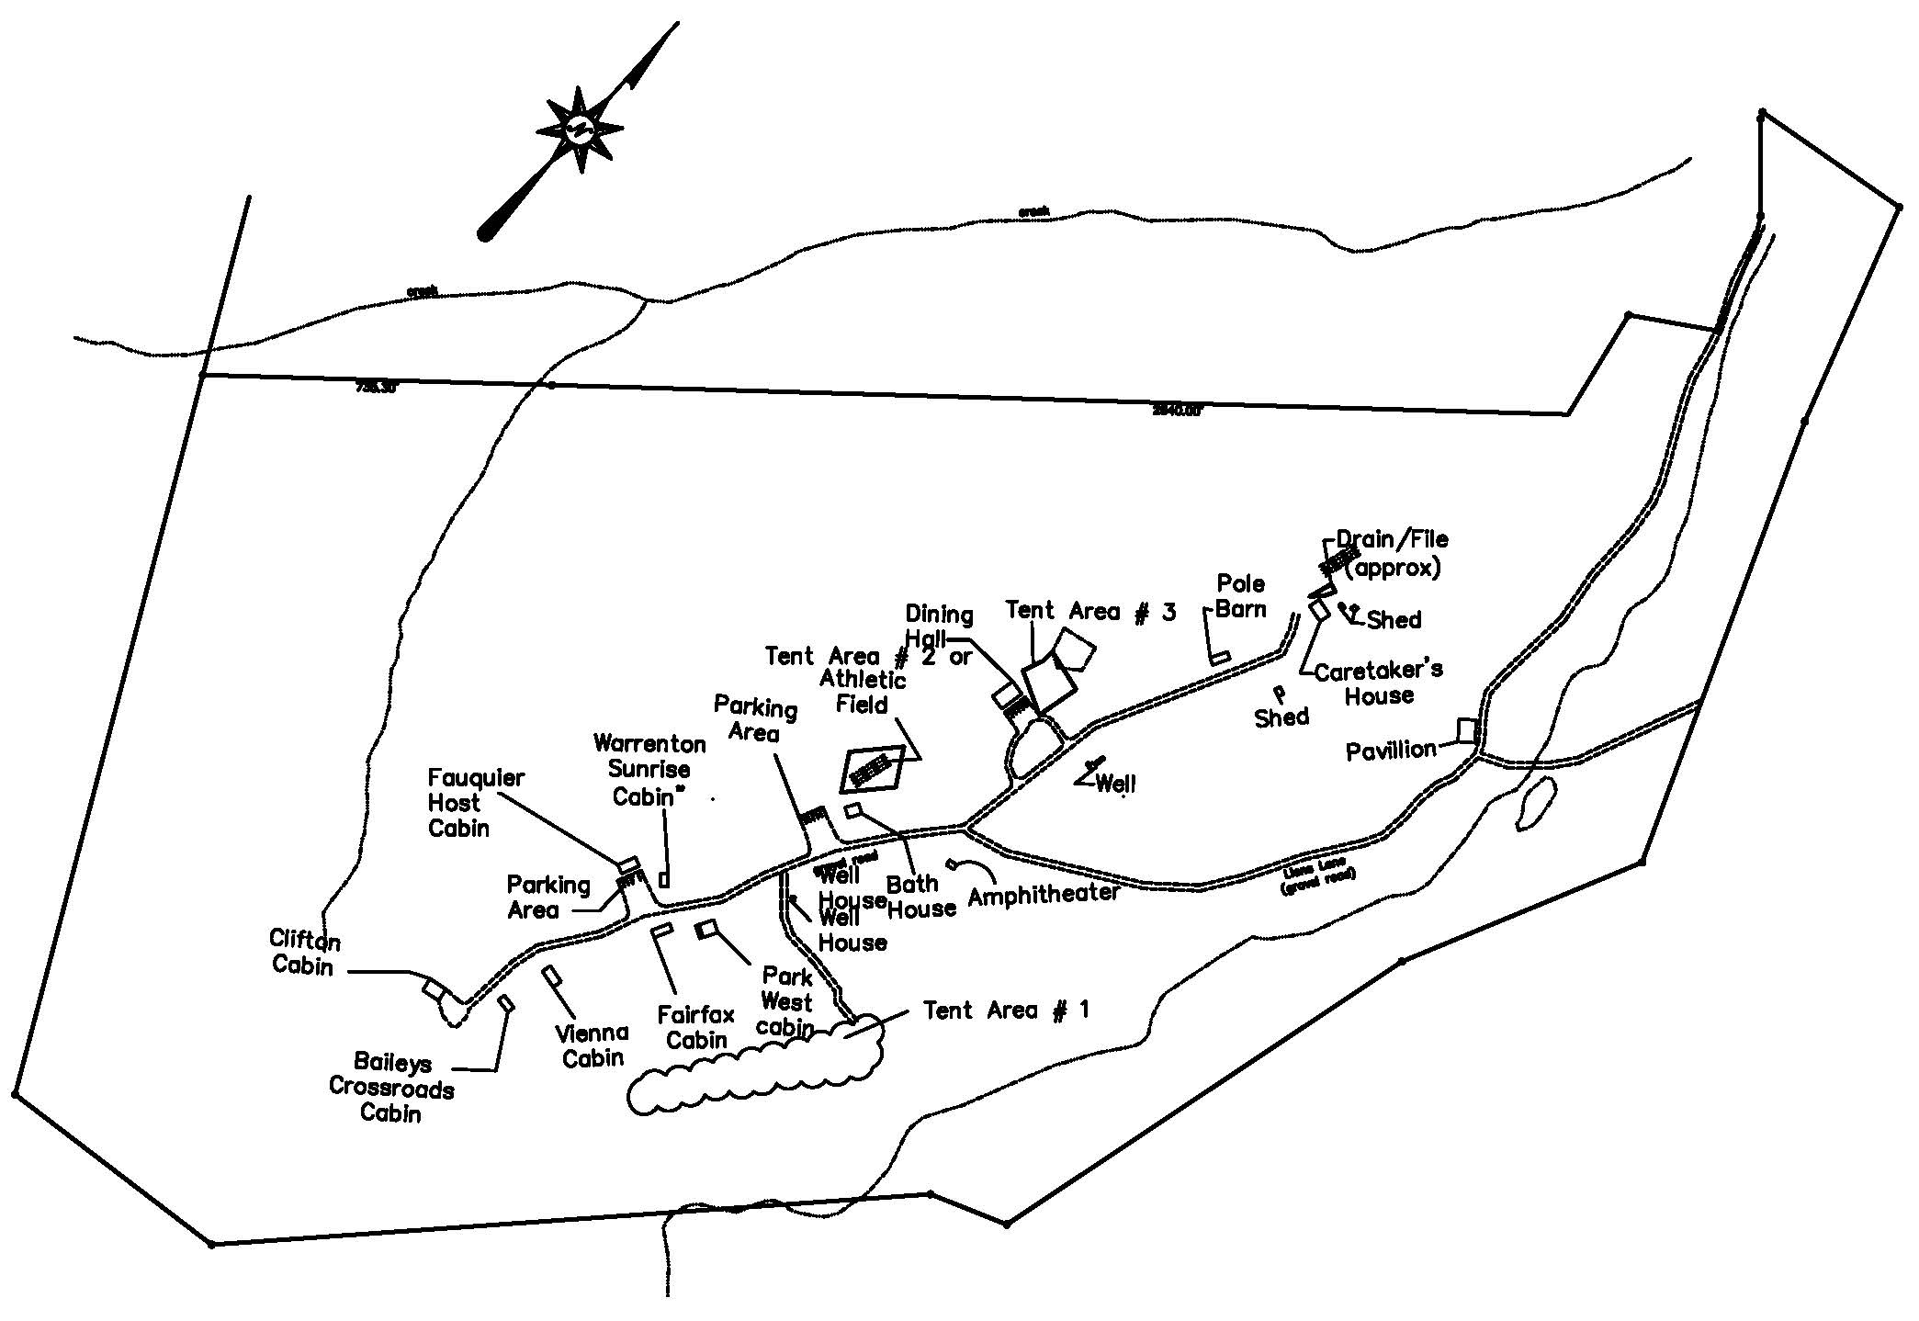
NVLYC CAMPUS MAP

Slide 9
NVLYC USAGE BY FISCAL YEAR
# YEARS | Fiscal Years | Youth | Adults | Total
15 | 2003-2018 | 1824 | 8445 | 26866
16 | 2018-2019 | 1121 | 519 | 1640
17 | 2019-2020 | 823 | 317 | 1166
18 | 2020-2021 | 764 | 315 | 1079
19 | 2021-2022 | 508 | 243 | 751
20 | 2022-2023 | 567 | 300 | 867
21 | 2023-2024 | 1057 | 721 | 1778
22 | 2024-2025 | 1133 | 704 | 1837
23 | 2025-2026* | 635 | 627 | 1262
24 | 2026-2027# | 0 | 310 | 310
 | Total | 8432 | 12501 | 37556
22 Year Average
 | Average | 1122 | 537 | 1659
* MORE EVENTS WILL BE SCHEDULED
# 6 EVENTS ARE SCHEDULED THRU DECEMBER 2026

Slide 10
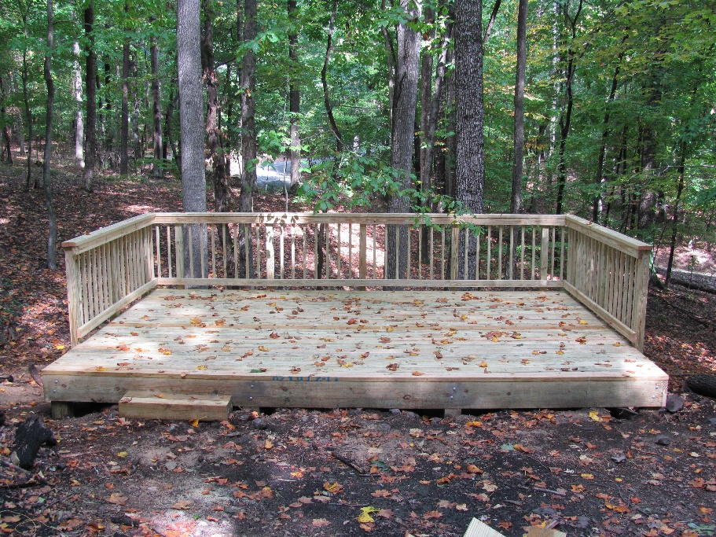
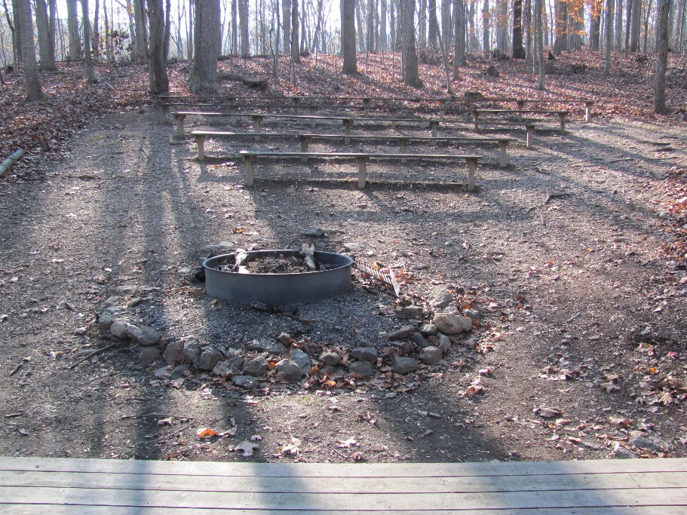
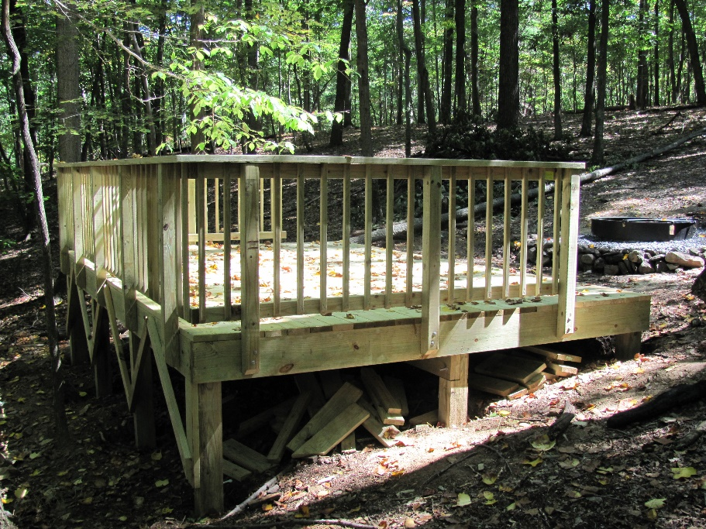
AMPHITHEATER
BUILT SEPTEMBER 2010

Slide 11
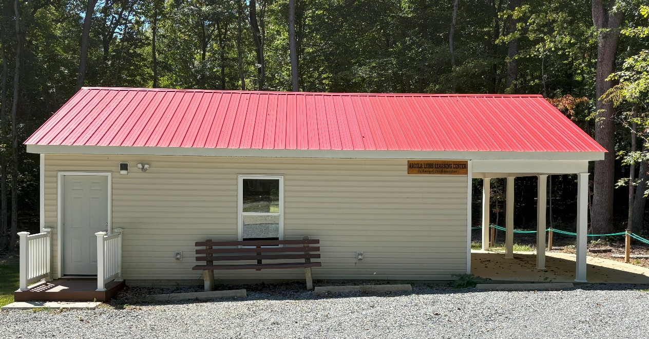
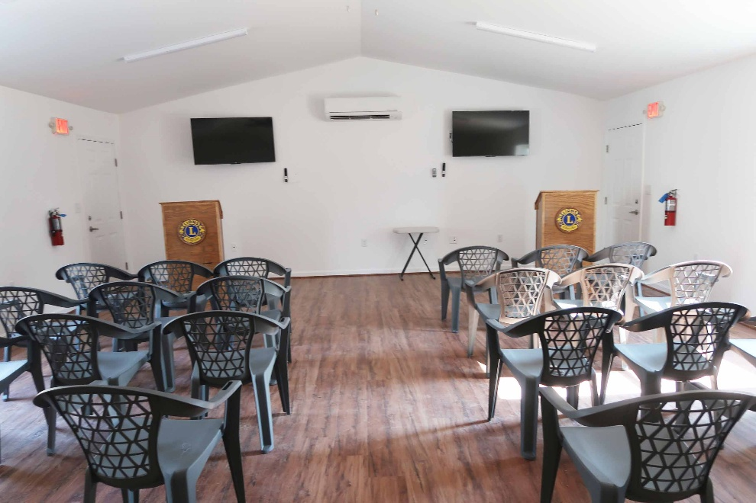
ARCOLA LEARNNG CENTER (MONTE GIBSON)
DEDICATED MAY 2024
SLEEPS 4

Slide 12
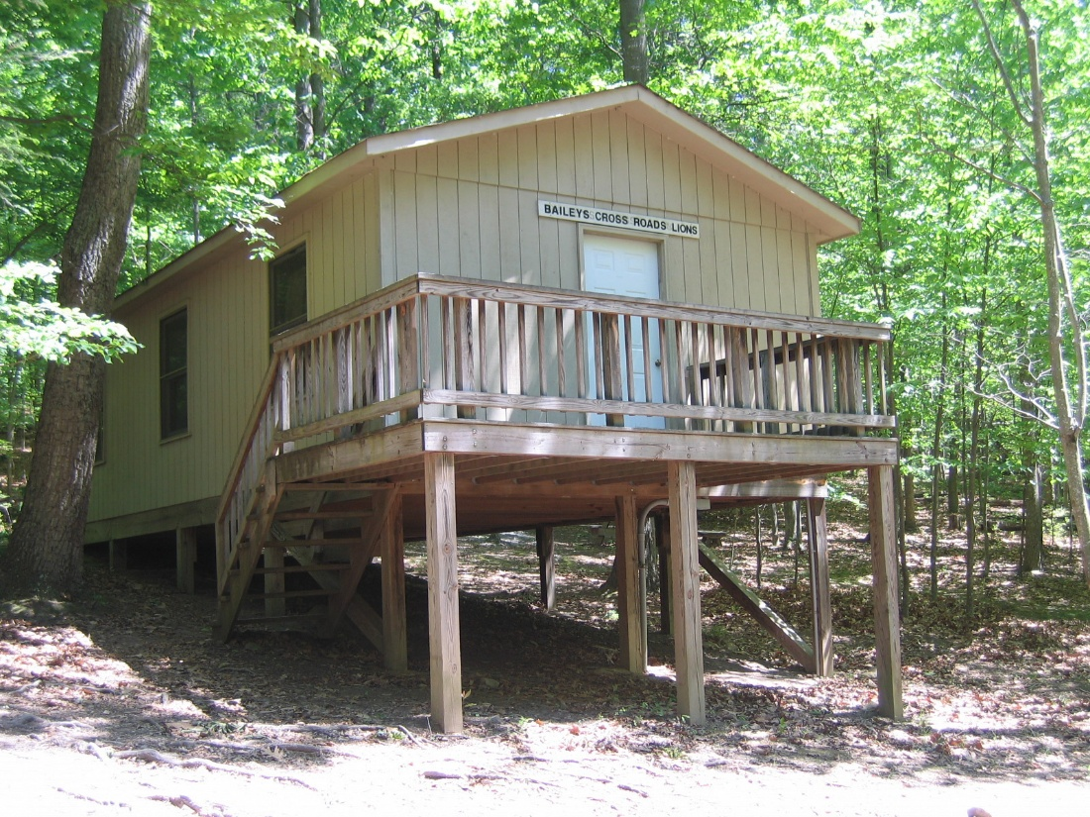
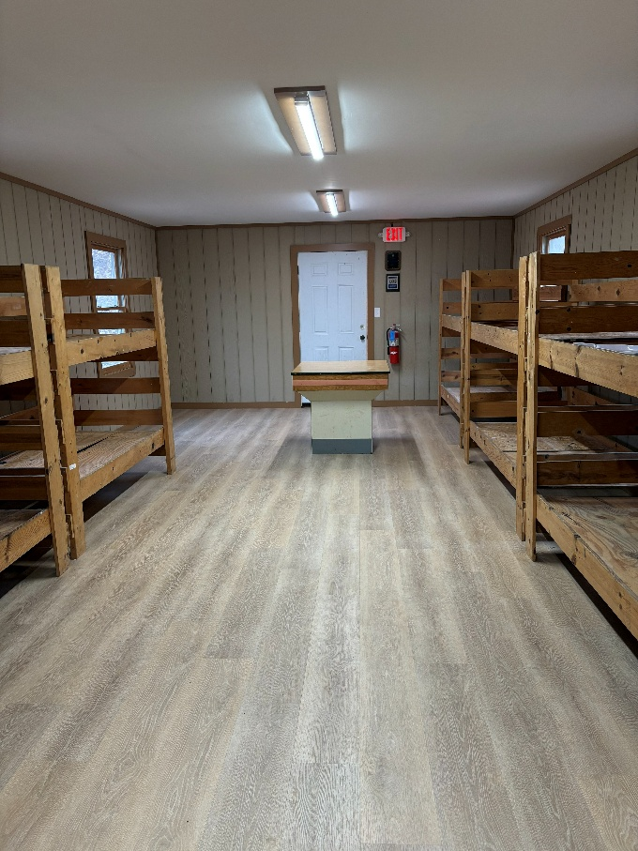
BAILEYS CROSSROAD CABIN
SLEEPS 18

Slide 13
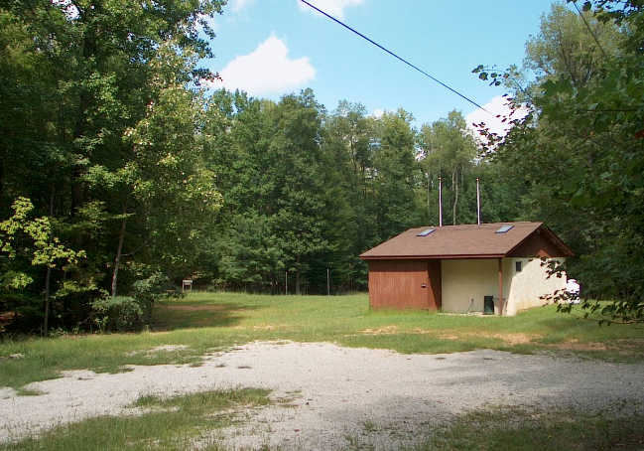
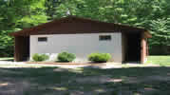
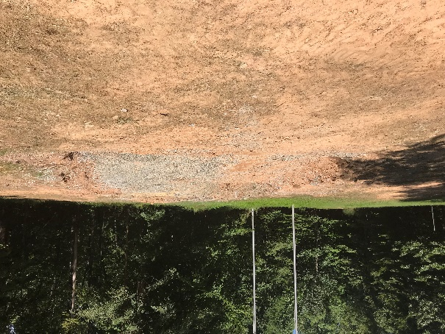
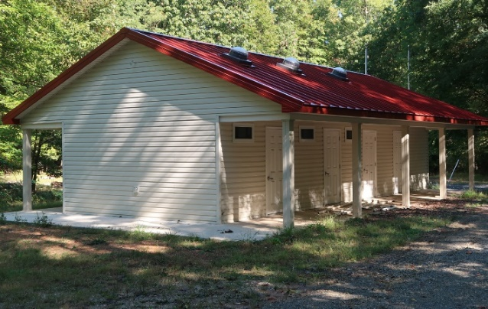
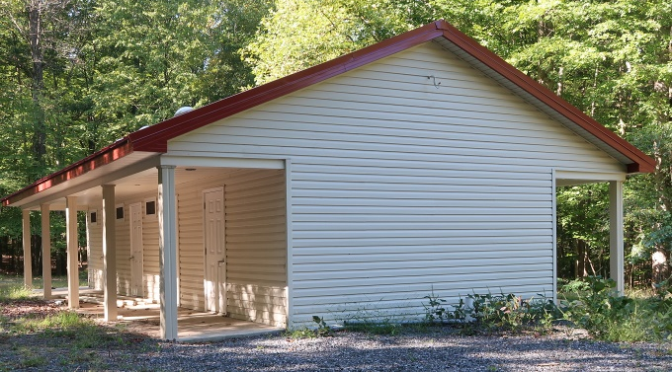
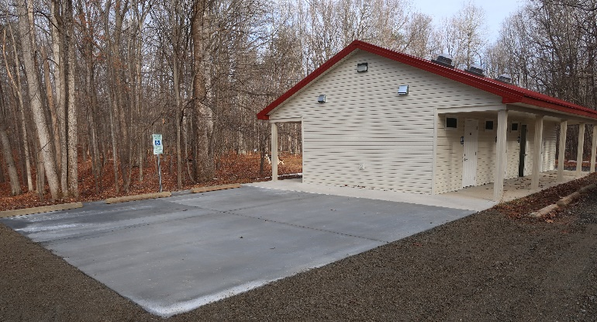
BATH HOUSE

Slide 14
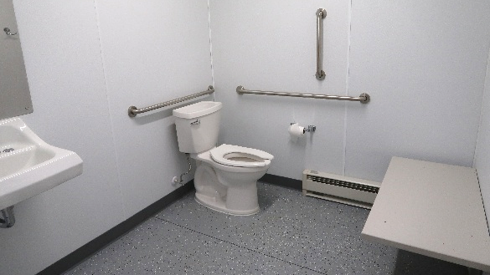
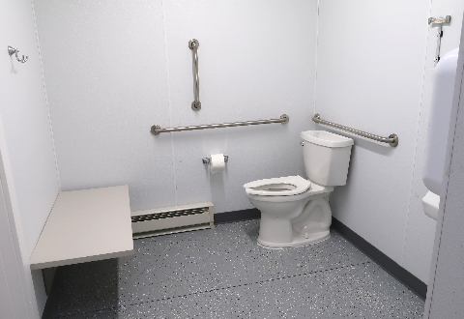
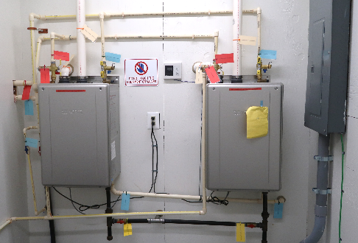
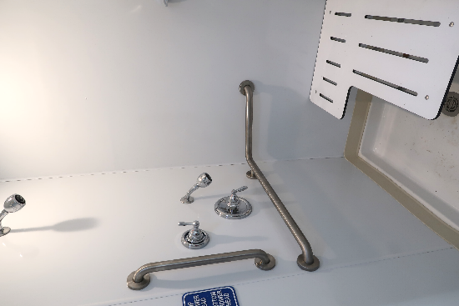

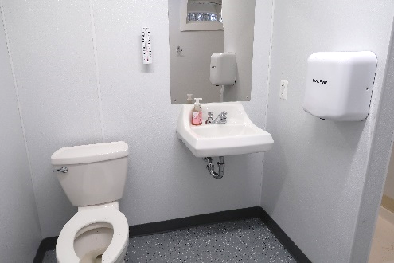
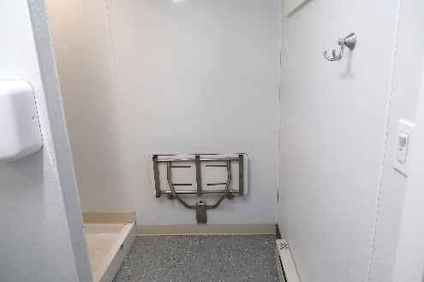
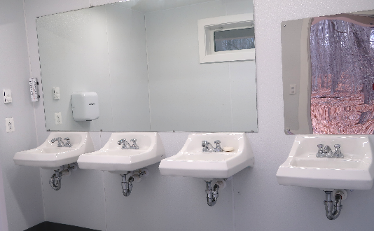
BATH HOUSE

Slide 15
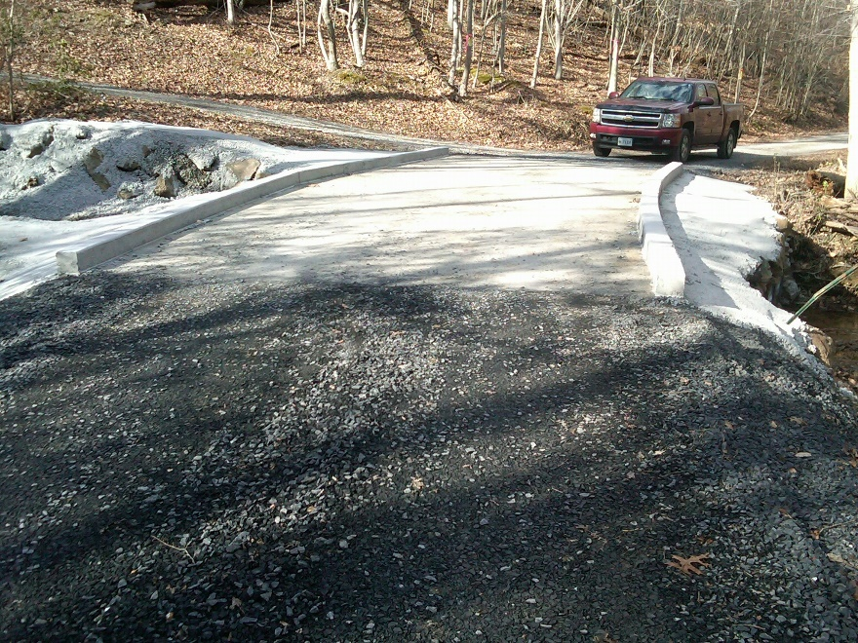
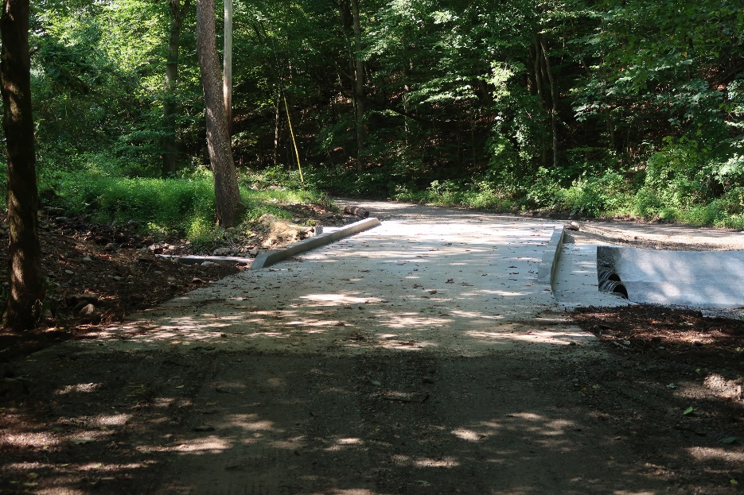
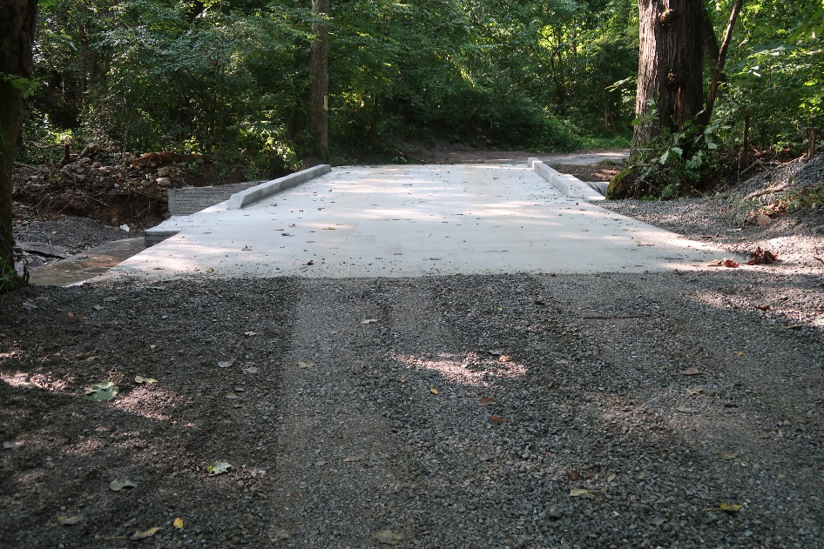
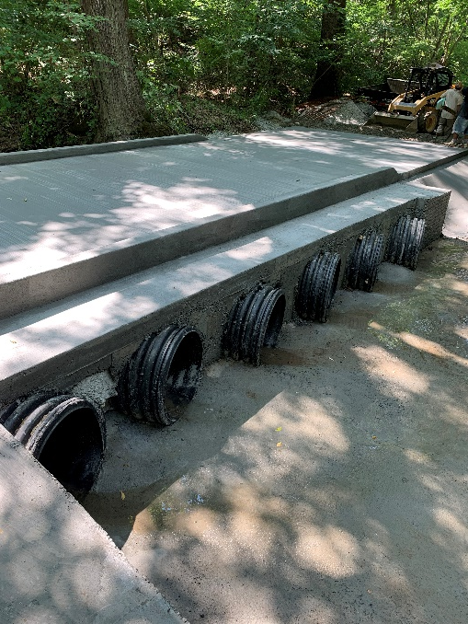
BRIDGES

Slide 16
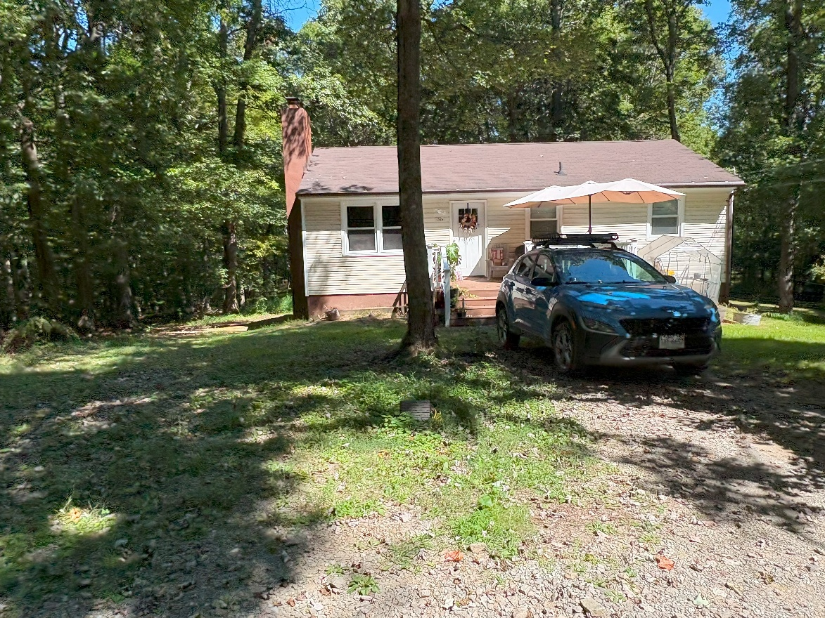
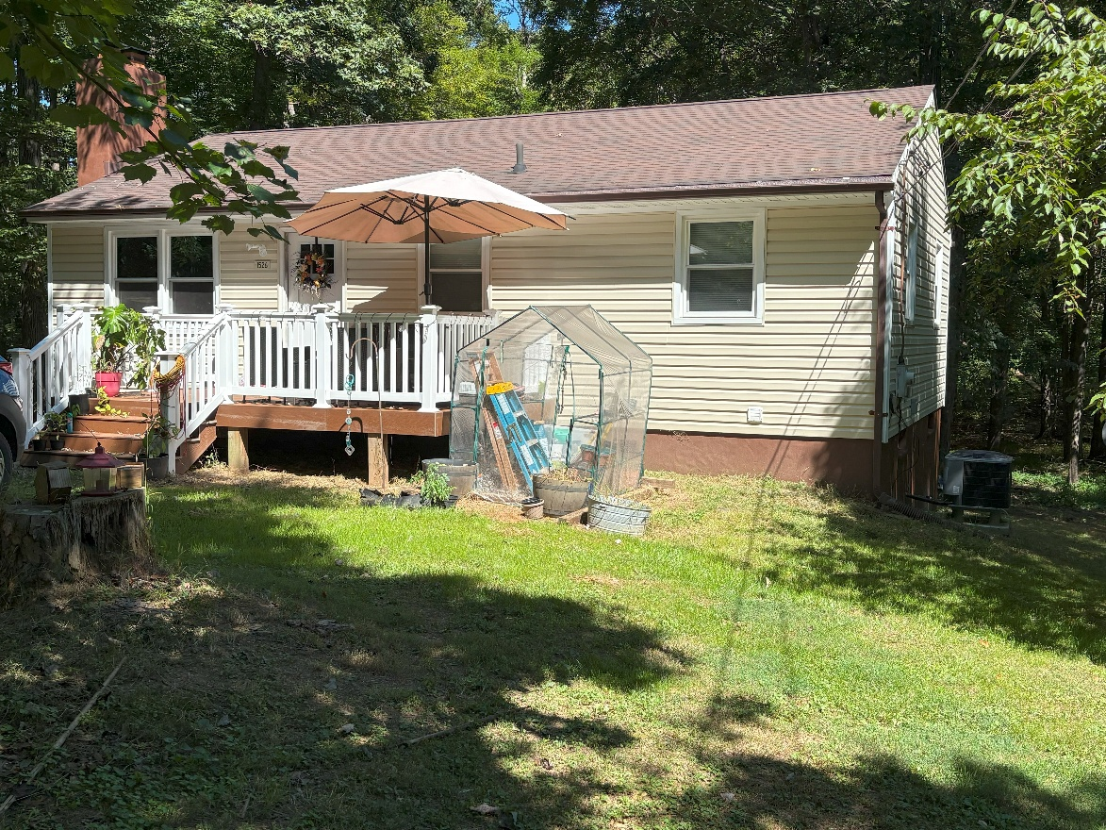
CARE TAKER’S COTTAGE
REMODELED 2024-2025
.

Slide 17
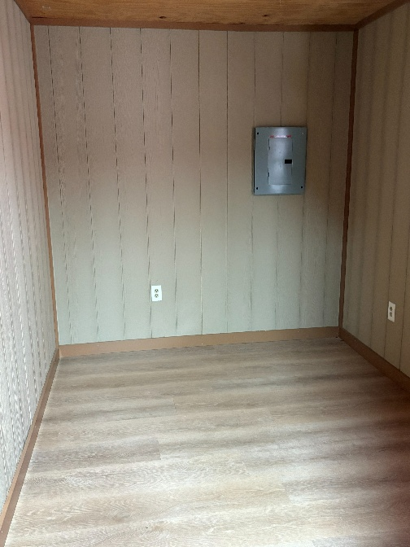
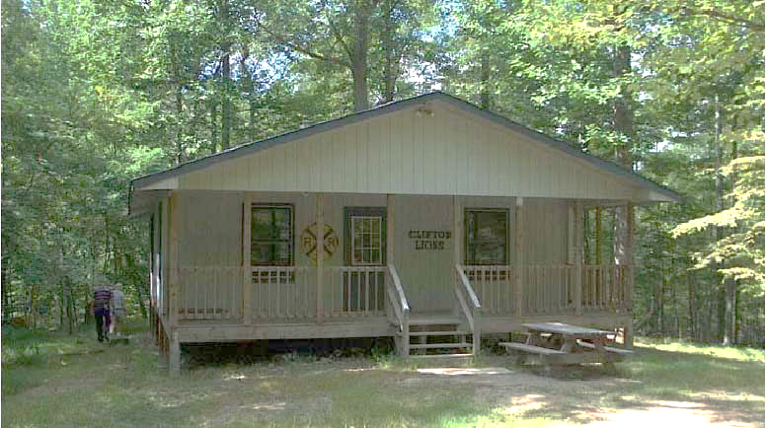
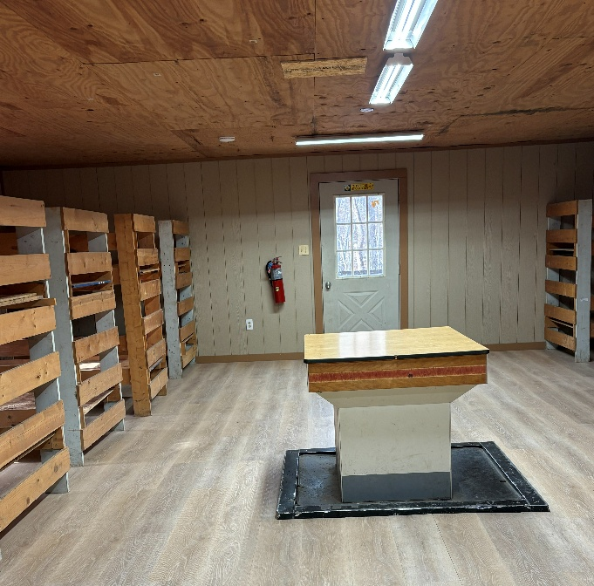
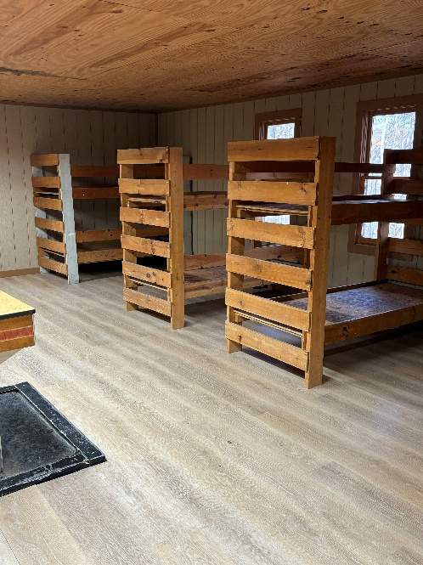
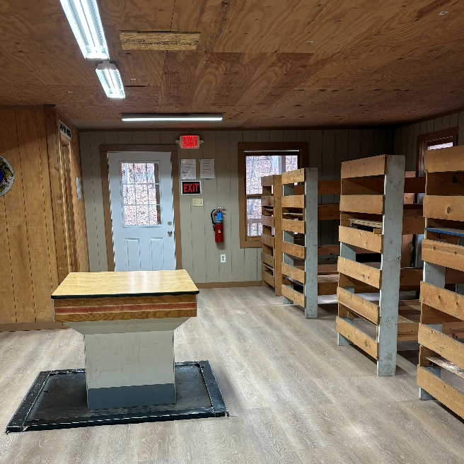
CLIFTON
SLEEPS 22

Slide 18
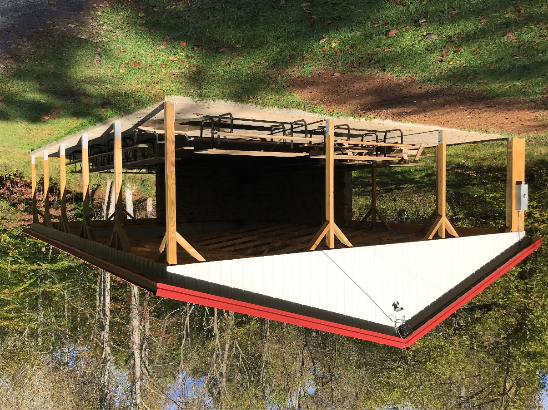
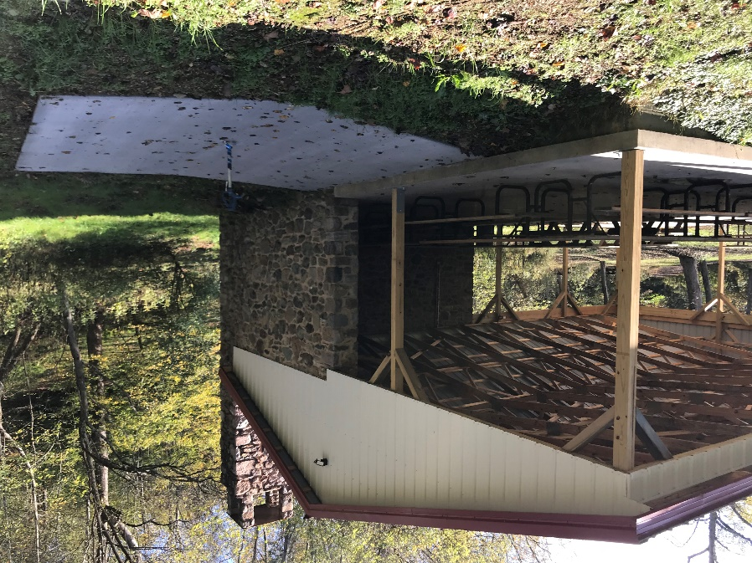
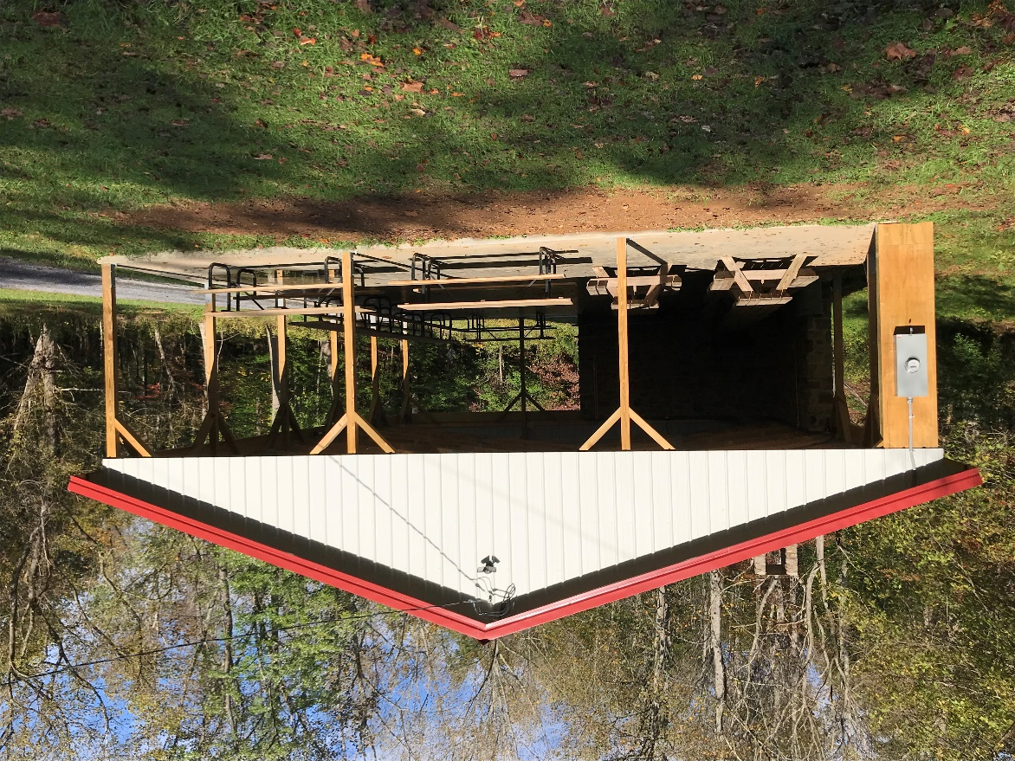

DAVIS PAVILION (DEDICATED APRIL 2017)

Slide 19
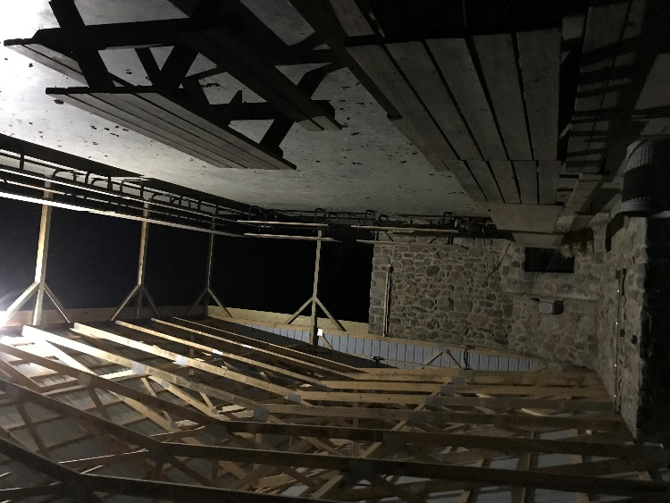
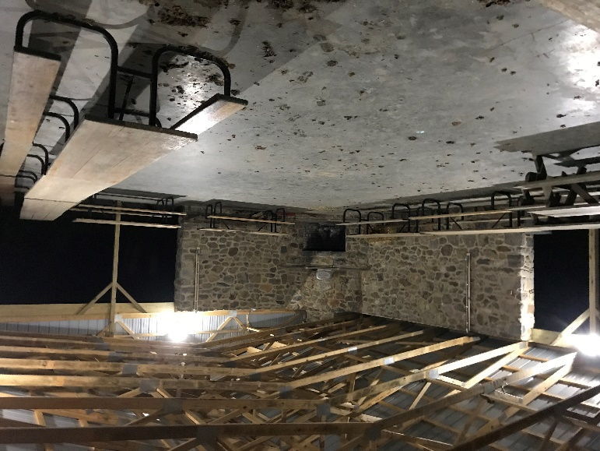
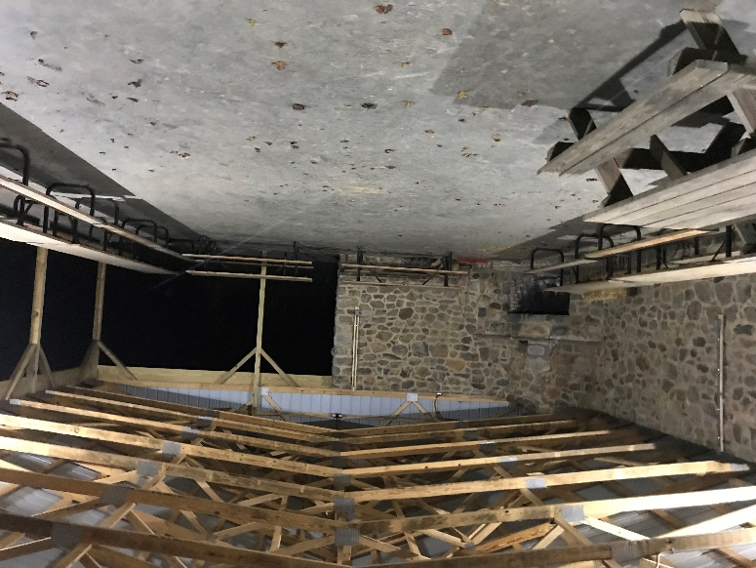
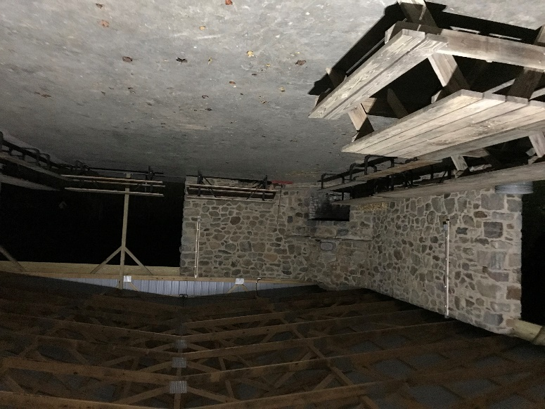
DAVIS PAVILION

Slide 20
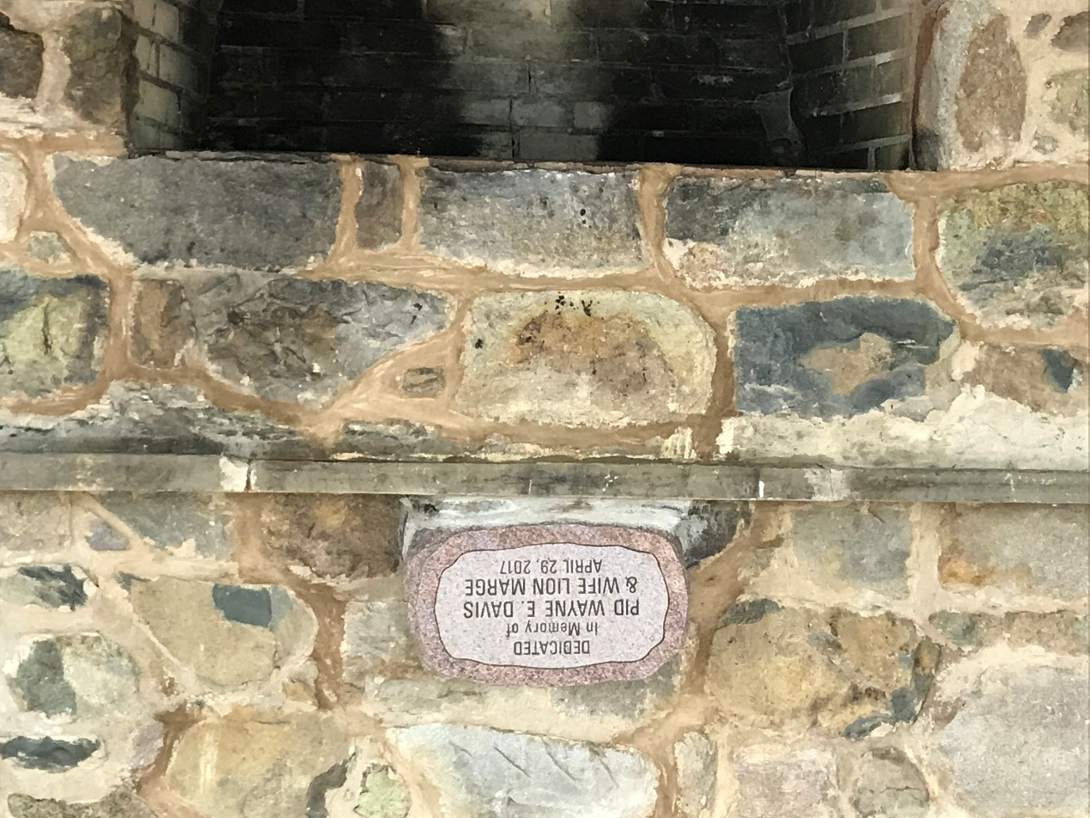
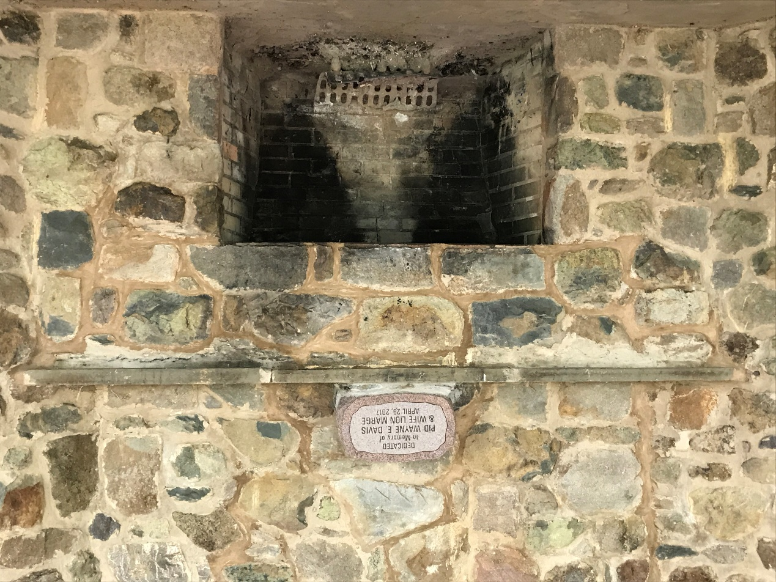
DAVIS PAVILION

Slide 21
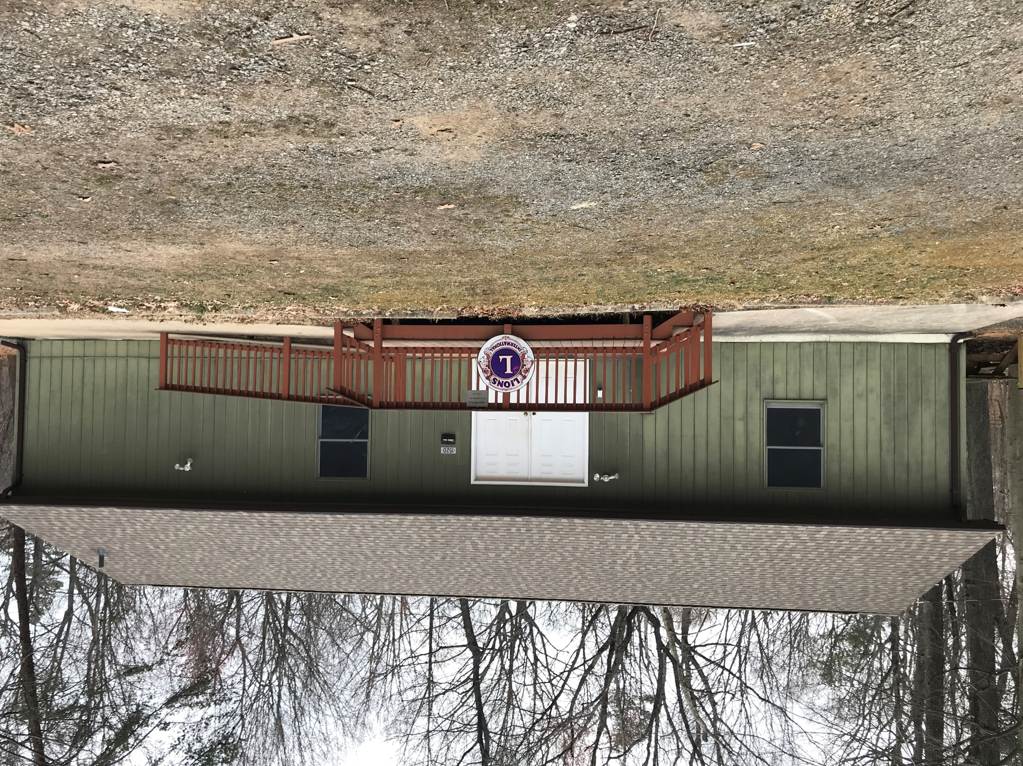
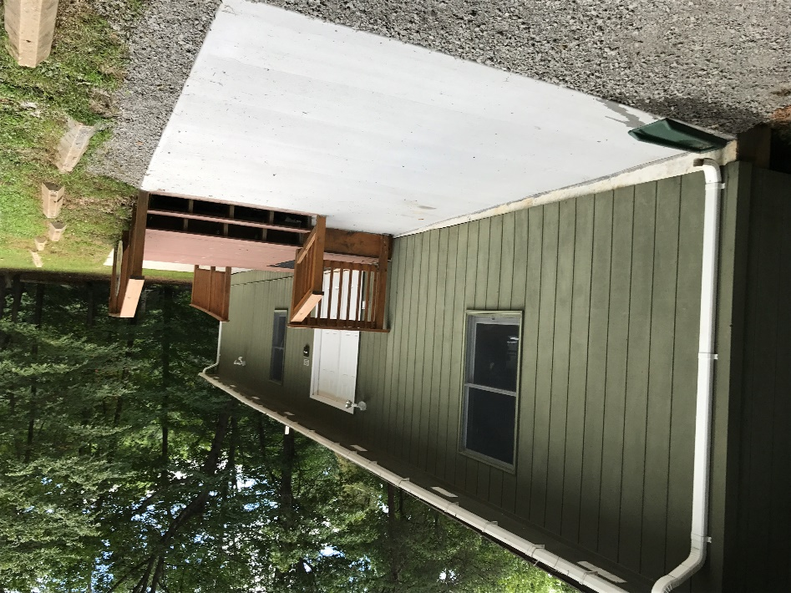
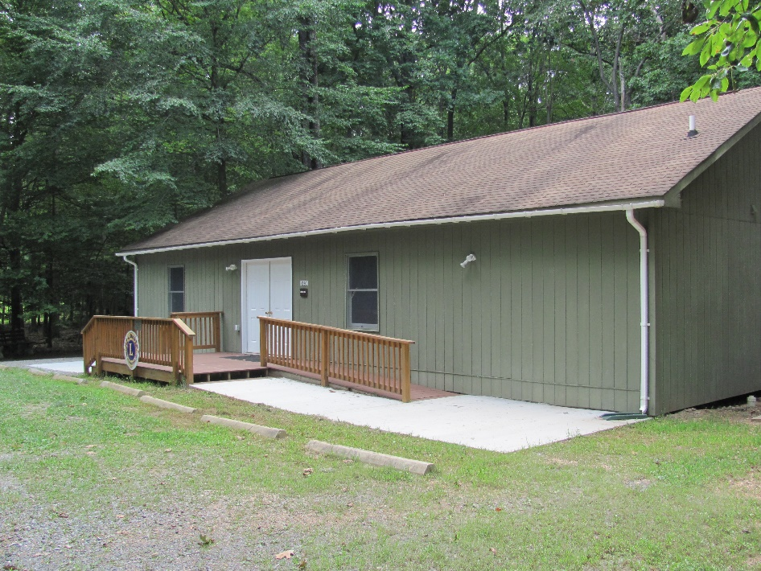
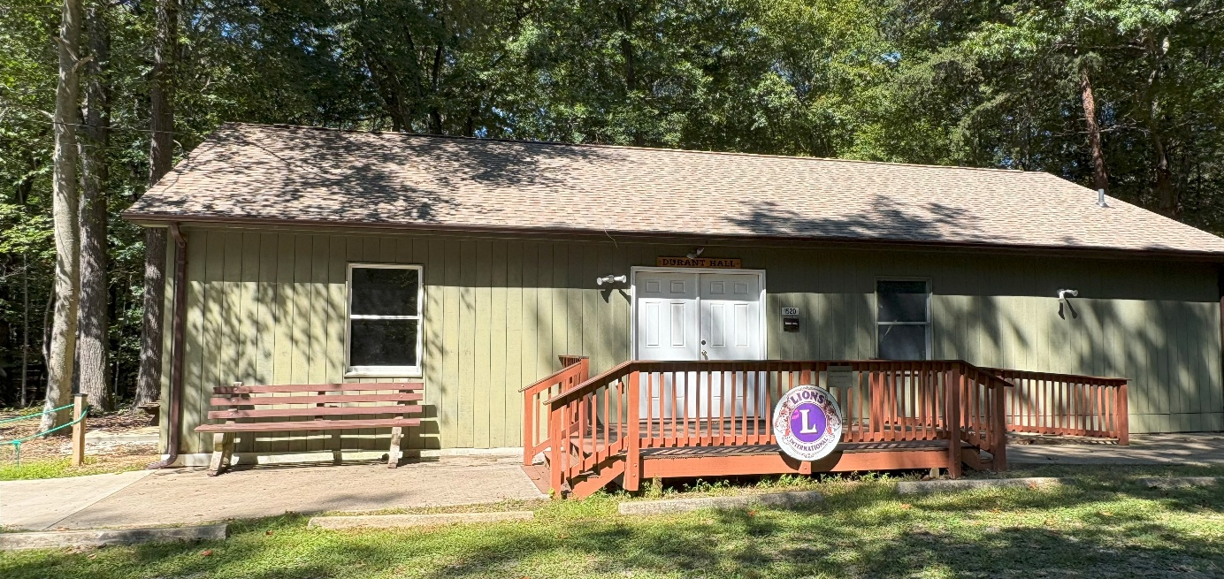
DURANT HALL
CAPACITY 50 PEOPLE

Slide 22
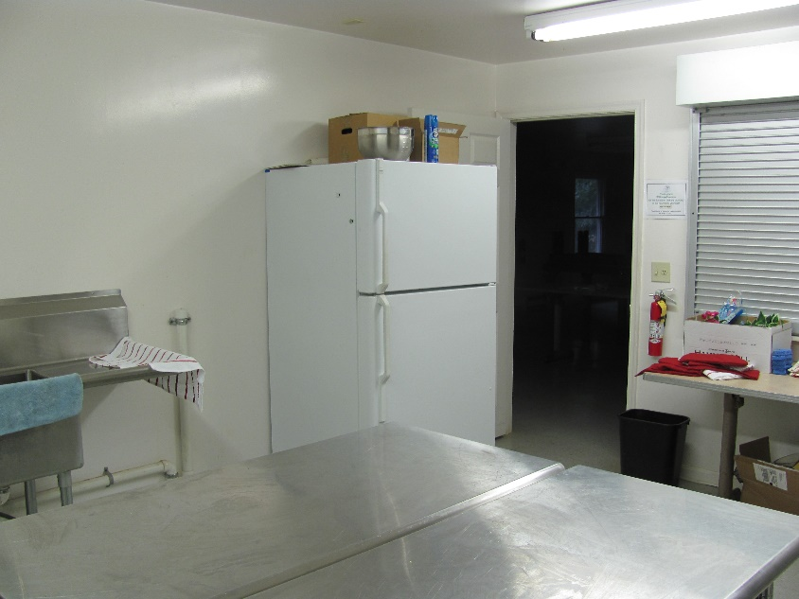
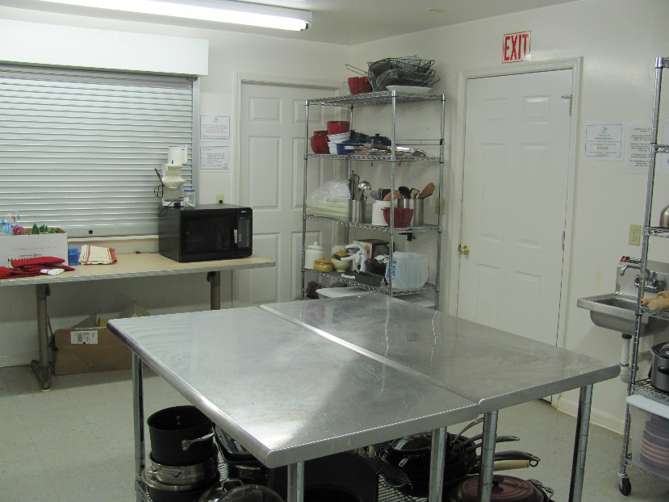
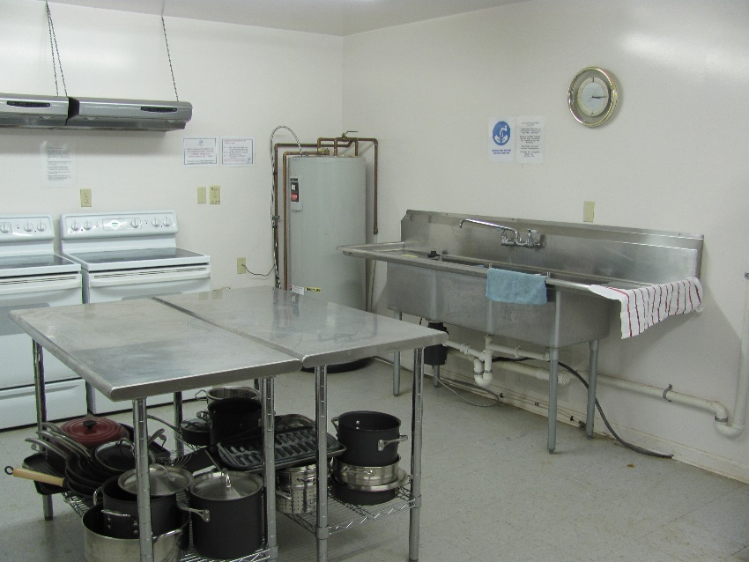
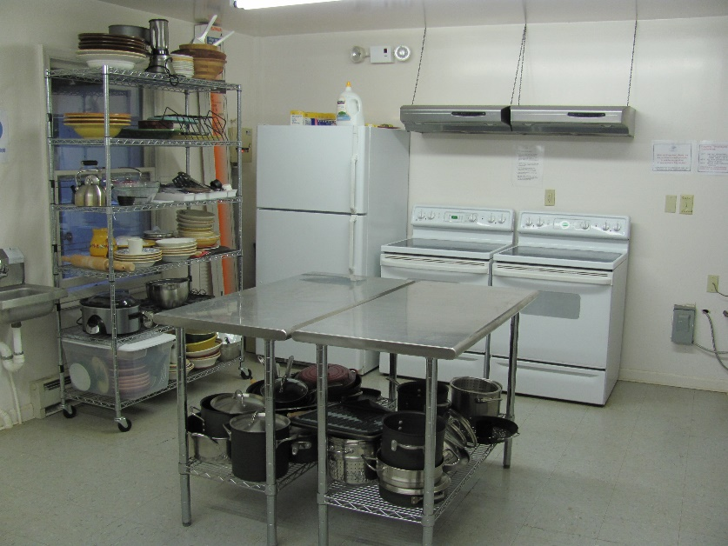
DURANT HALL

Slide 23



FAIRFAX HOST CABIN
SLEEPS 12

Slide 24

PARK WEST LIONS CLUB
SLEEPS 20

Slide 25


VIENNA HOST CABIN
SLEEPS 18

Slide 26


WARRENTON SUNISE CABIN
BUILT FEBRUARY 2013
SLEEPS 8

Slide 27


WOODBRIDGE CABIN
SLEEPS 20

Slide 28





CABINS TOTAL CABIN CAPACITY 122
ARCOLA LEARNING CENTER SLEEPS 4
BAILEYS CROSSROAD SLEEPS 18
CLIFTON SLEEPS 22
FAIRFAX HOST SLEEPS 12
PARK WEST SLEEPS 20

Slide 29



CABINS TOTAL CABIN CAPACITY 122
VIENNA HOST SLEEPS 18
WARRENTON SUNRISE SLEEPS 8
WOODBRIDGE SLEEPS 20

Slide 30
PUBLIC WATER SYSTEM
2 WELLS
OLD WELL YIELDS ~ 3-4 GALLONS/ MINUTES
USED FOR THE BATH HOUSE
NEW WELL YIELDS ~ 8-10 GALLONS/MINUTES
USED FOR DURANT HALL AND THE CARE TAKERS HOUSE
5000 GALLON PRESSURE TANK
WATER SAMPLE TESTING QUARTERLY
AT DIFFERENT LOCATIONS

Slide 31



PUBLIC WATER SYSTEM

Slide 32




BOY SCOUTS EAGLE PROJECT

Slide 33
NVLYC INFORMATION
A CORPORTATION/FOUNDATION CHARTER IN THE COMMONWEALTH OF VIRGINIA
GOVERNED BY A BOARD OF DIRECTORS
501 _{C(3)} TAX EXEMPT

Slide 34
FINANCES
INCOME
RENTALS
CAMPING FEES $8.00/CAMPER/NIGHT (INCREASE $10.00/CAMPER/NIGHT) JULY 2026)
SECURITY DEPOSITIES
CAMP $100.00
APPLIED TO CAMP RENTAL
DONATIONS
LIONS CLUBS
INDIVIDUALS
FUND RAISING
GRANTS

Slide 35
EXPENSES
OPERATION OF THE CAMP PER YEAR IS $20,000-$25,000/YEAR
REAL ESTATE TAXES
INSURANCE
DAILY MAINTENANCE
UTILITIES
ELECTRICAL BILLS
TELEPHONE
WATER TESTING

Slide 36
GRANTS AND DONATIONS
LOVF MATCHING GRANT (DECEMBER 2018)
LOVF MATCHING GRANT (SEPTEMBER 2021)
ARCOLA GRANT (JANUARY 2024)
HOME DEPOT GRANT (MAY 2025)
THESE GRANTS WERE RESTRICTED FUNDS. MONEY CAN ONLY BE USED FOR THE ITEMS LISTED IN THE GRANT.

Slide 37
CARE TAKER
RENT FREE
PROVIDE WATER
MAINTENANCE ON THE CARE TAKERS COTTAGE
PAYS FOR UTILITIES
ELECTRIC
PHONE
TV
HEATING/COOLING
DUTIES
SECURITY
LIGHT MAINTANCE
SNOW REMOVAL
GRASS MOWING

Slide 38
OPPORTUNITIES
EARTH DAY & OPEN HOUSE
APRIL 25, 2026

Slide 39
QUESTIONS
MY TIME IS UP AND I THANK YOU FOR YOURS!!

Slide 40
STOP!!!!

